Slide 1
The English Renaissance
1485-1660

Slide 2
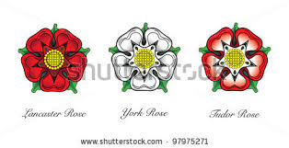
1455-1485
The Wars of the Roses, aka Civil Wars
House of Lancaster (red rose) vs House of York (white rose)
Fought as a result of the Hundred Years War (social and economic problems)
Henry Tudor (aka Henry VII) defeated Richard III
Restoration of political stability
Tudor England: 1485-1603

Slide 3
1485-1509: Henry VII
Sought to unify England after years of civil war
4 children: Arthur, Henry, Margaret, Mary
Died in 1509 of tuberculosis
Left England more stable and significantly wealthier
Arthur was supposed to be king, but he died in 1502 at age 15 (Arthur married Katherine of Aragon in 1501; he died 4 months later), so that brings us to…

Slide 4
1509-1547: Henry VIII
Succeeds his father (Henry VII)
Originally was going into the Church (very religious)
1517: Martin Luther, 95 Theses
Henry writes a treatise against Luther, Pope awards him the title, “Defender of the Faith” (still part of the monarch’s title today)
1527: seeks annulment from the Church; denied
1529-1536: Reformation Parliament (separating gov’t from church)
1534: Act of Supremacy gives power of the church to the king; Henry declares himself Head of the Church of England

Slide 5
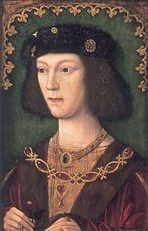
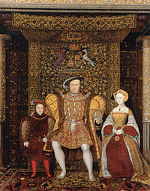
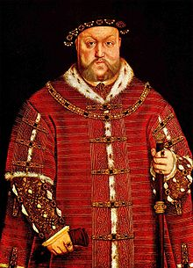
Henry through the Years
1509, 18 yrs old
1542, 51 yrs old (4 years before death)
1535 (with Jane Seymour and son Edward)
1531, 40 yrs old

Slide 6
The WIVES
Katherine of Aragon: m. 1509-1533/annulment
one (surviving) child: Mary
Anne Boleyn: m. 1533-1536/executed
one child: Elizabeth
Jane Seymour: m. 1536-1537/ died in childbirth
one child: Edward
Anne of Cleves: m. 1540/annulment
no children
Catherine Howard: m. 1540-1541/executed
no children
Katherine Parr: m. 1543-1547
no children/ Henry’s widow

Slide 7
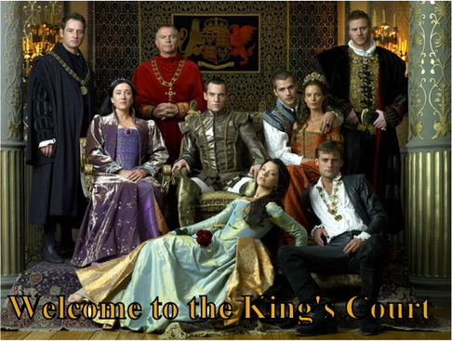
The Tudors and pop culture
No one actually
looked like this…
The Tudors,
Showtime
But there is this clever little ditty
And this is probably my favorite.

Slide 8
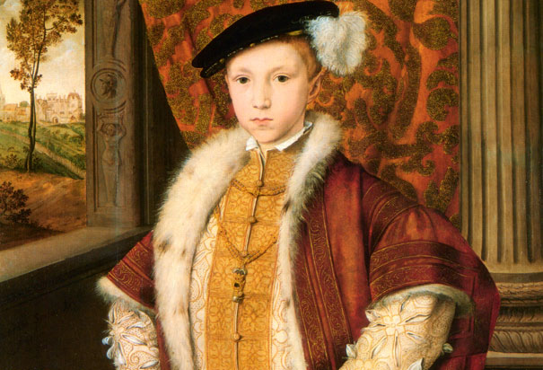
1547-1553
Edward VI, the boy king
Had essentially no power; ruled by an advisory council
Strengthened ties to Protestantism
Died of tuberculosis at the age of 16

Slide 9
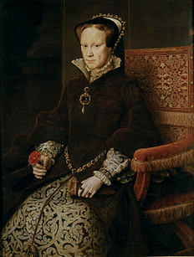
1553-1558
Lady Jane Grey ruled for 9 days after Edward’s death
Mary (daughter of Katherine of Aragon and Henry VIII) took the throne
Returned England to Catholicism
“Bloody Mary”
Public burnings of Protestants
(over 300)
Married Philip II of Spain,
no children

Slide 10
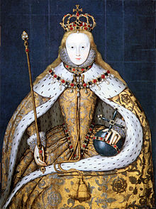
1559-1603: Elizabethan period
Elizabeth, daughter of
Anne Boleyn and Henry VIII
imprisoned in Tower of London
by her half-sister Mary
Mary feared Elizabeth’s
popularity and her Protestantism
Elizabeth ascends the throne when Mary dies

Slide 11
Elizabeth I “the Virgin Queen”—never married Returns England to the Church of England in 1559 Zealous Protestants and Catholics unhappy (Church of England is a compromise: Catholicism minus the Pope) 1588: defeated the Spanish Armada Her death = END OF TUDOR ERA (1485-1603) “I’m so fancy/you already know”

Slide 12
1603-1688
House of the Stuarts
James I
Charles I
Interregnum (end of Renaissance)
Charles II (Restoration)
James II

Slide 13
1603-1625: Jacobean period
Upon Elizabeth’s death, no immediate heir
James VI of Scotland, great-great grandson of Henry VII, son of Mary Queen of Scots and first cousin of Elizabeth, becomes James I of England (first time Scotland and England are combined under one ruler)
He was fascinated by the supernatural
Shakespeare wrote Macbeth to please King James
The Bible? He’s THAT King James. (1611)
NB: Scotland and England become Protestant; Ireland, under British rule since 12th century, stayed Catholic. Lays groundwork for future conflict btw England and Ireland (1700’s-1900’s)

Slide 14
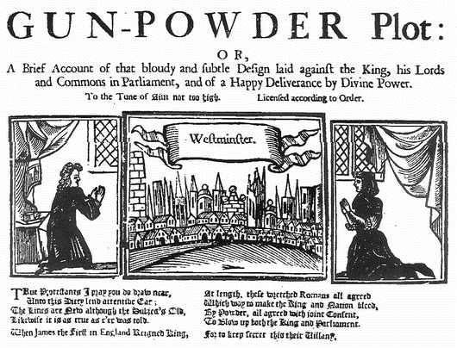
1605: Gunpowder Plot and Aftermath
Gunpowder Plot—failed attempt to assassinate King James by a group of Catholic farmers, led by Guy Fawkes
“Remember remember
the 5th of November”
Popish Recreants Act—forbade Roman Catholics from professions of law and medicine and from acting as a guardian or trustee, also from possessing weapons
Must forfeit two-thirds of his land if he did not receive the sacrament of the Lord's Supper at least once a year in his Church of England parish church

Slide 15
1625-1649
Charles I (James’ 2nd son; brother died in 1612)
Married a Catholic, fought with Parliament, believed in Divine Right of Kings
Immensely unpopular—considered a tyrannical monarch
English Civil War: 1642-1647—King vs. Parliamentary forces
The King lost; executed in 1649 for treason

Slide 16
1649-1660: the English Interregnum inter = between regnum = kingdom
The Commonwealth of England!
No monarch; led by Lord Protector Oliver Cromwell
Became increasingly unstable
Irish Confederate Wars: 1641-1653
Cromwell led the army that defeated Irish forces (1649-1653)
Act for the Settlement of Ireland, 1652: As punishment for rebellion, Catholics lost rights to own land

Slide 17
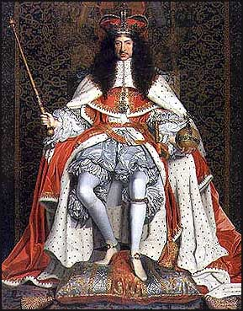
1660-1685
Beginning of the Restoration
Charles II was RESTORED to the throne (get it?)

