Slide 1
Introduction to
A Portrait of the Artist as a Young Man
DiMatteo/AP English 12

Slide 2
Open to page one…
WAIT!!

Slide 3
Examining the Title
A Portrait of the Artist…
-it’s subjective: not the only one!
-portrait: representative of artistic expression
-really, Joyce? Self-important much?
-indicates overlap of visual and written arts as a form of personal expression

Slide 4
Examining the Title cont’d
…as a Young Man
-representative of age, naivete, and the most formative experiences in one’s life

Slide 5
Author: JAMES JOYCE
Easy enough, right?
So artist must = Joyce!
Nope.
Main character = Stephen Dedalus; a parallel for Joyce, but not directly autobiographical

Slide 6
Speaking of Style…
Perhaps the most influential Modernist novel. Period.
Bildungsroman
Stream of Consciousness
Highly stylized memoir

Slide 7
Main Character
Stephen Dedalus
-St. Stephen: 1st Christian martyr
-Daedalus: Greek inventor (pagan artist)
-representative of dual identity, tension of home-life expectations and his personal desire to be an individual

Slide 8
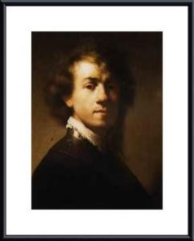
“A Portrait of the Artist as a Young Man” by Rembrandt

Slide 9
Another perspective
Rembrandt would fix his gaze in the mirror to the world behind the mirror as he painted. Joyce’s use of the title may suggest the following chiasmic structure:
Background Painter Mirror Painter’s Image Background Image
Dublin Joyce Stephen “Dublin”

Slide 10
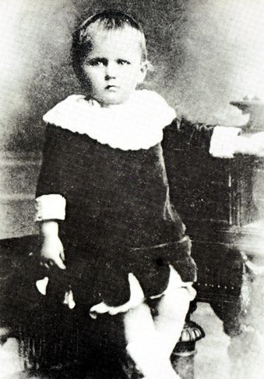
James Joyce at age 2
I’m already smarter than you.

Slide 11
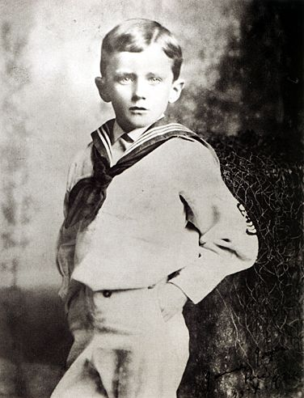
Joyce at age 6
How do you like me now? (I’m at Clongowes!)

Slide 12
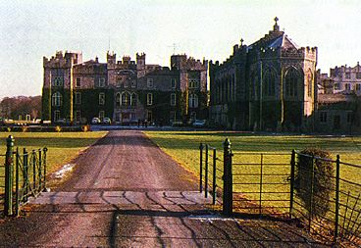
Clongowes school…originally a castle

Slide 13
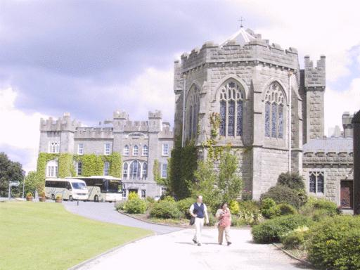
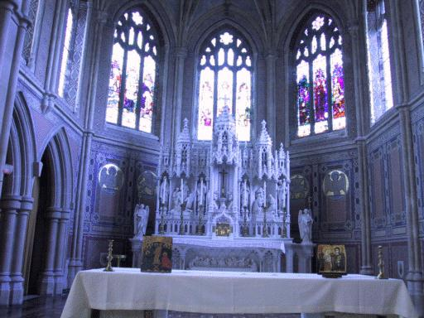
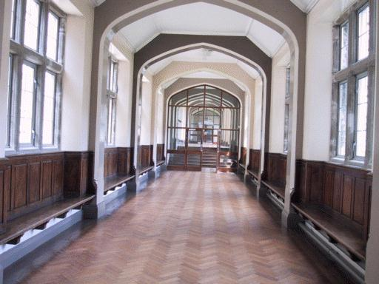
Clongowes

Slide 14
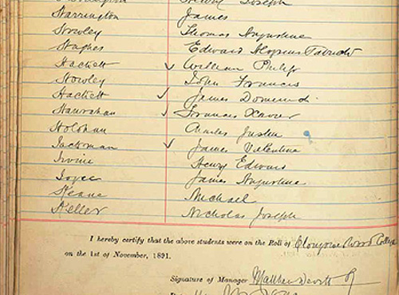
Signing in

Slide 15
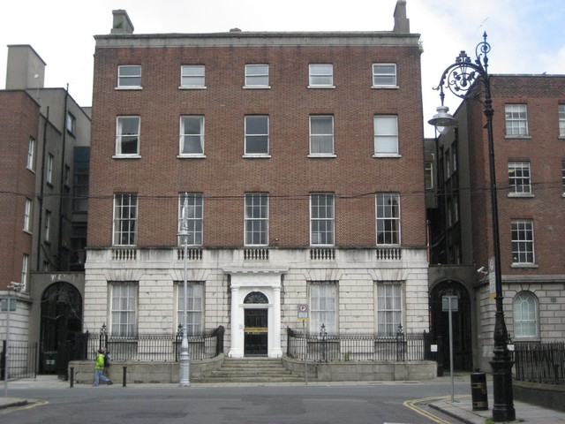
Belvedere College
Attended from age 8 until transferred to University College at Dublin

Slide 16
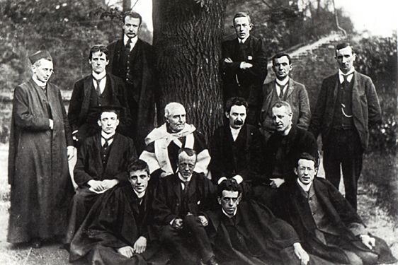
With his Buddies at School

Slide 17
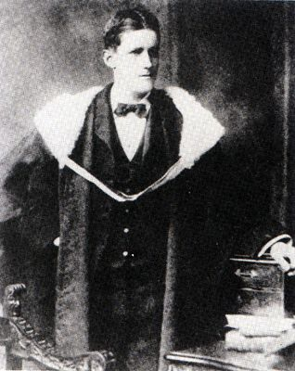
Joyce at
Graduation from
University
College of
Dublin

Slide 18
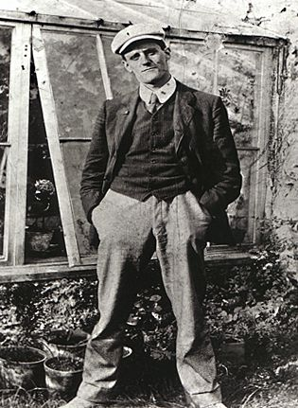
“In the beginning, there was the word…”
“I’m James Joyce. I like words. And different meanings. And sounds of words. And sounds of silence. And oxymorons. But not regular morons.”
(as interpreted by TND)

Slide 19
epigraph
Et ignotas animum dimittit in artes.
Ovid, Metamorphoses: VIII, 18
“And he applied his mind to the obscure arts.”
He=Daedalus
Obscure?
Less elementary, more creative, sophisticated, symbolic, UNKNOWN

Slide 20
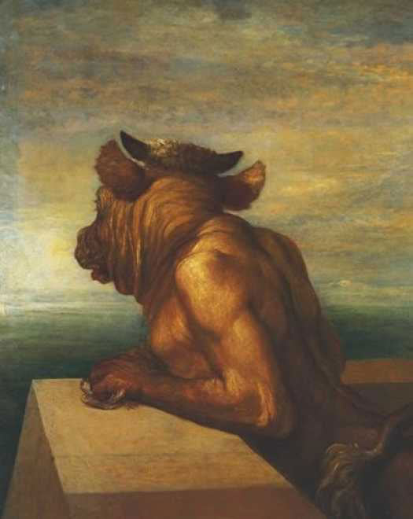
The Minotaur, George Watt (1885)

Slide 21

There’s this labyrinth…

Slide 22
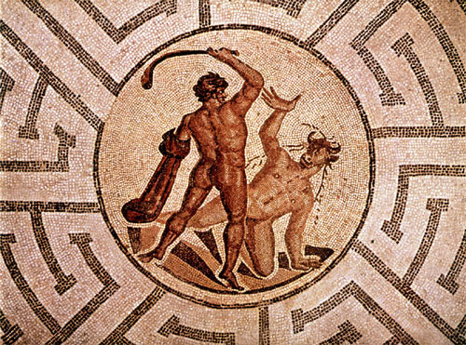
Theseus slaying the Minotaur. Stamnos by the Kleophrades Painter, c.500-450 BCE.

Slide 23
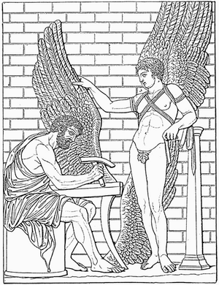
Daedalus constructs wings for his son, Icarus; Rome (1888).

Slide 24
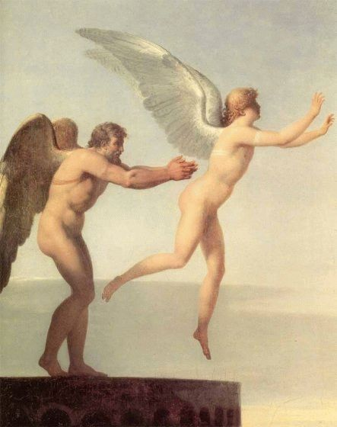
Icarus and Daedalus
Charles Paul Landon
1799

Slide 25
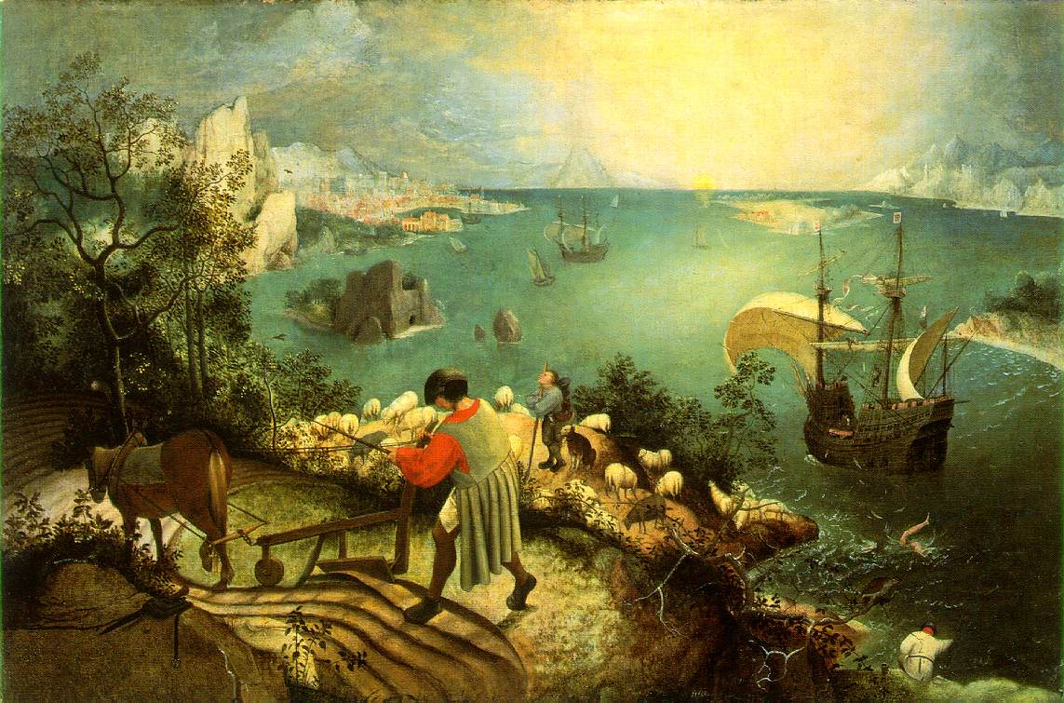
Landscape with the Fall of Icarus, c. 1558. Pieter Bruegel

Slide 26
Importance of Daedalus
Name means “cunning artificer”
‘artificer’?
Credited with inventing carpentry, the saw, axe, drill, glue, et al.
Romanticism: Daedalus = the classic artist (hardworking, dedicated to the craft)
Son Icarus = the creative artist (passionate but rebellious, may be self-destructive)

Slide 27
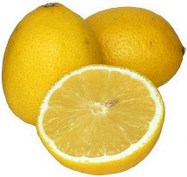
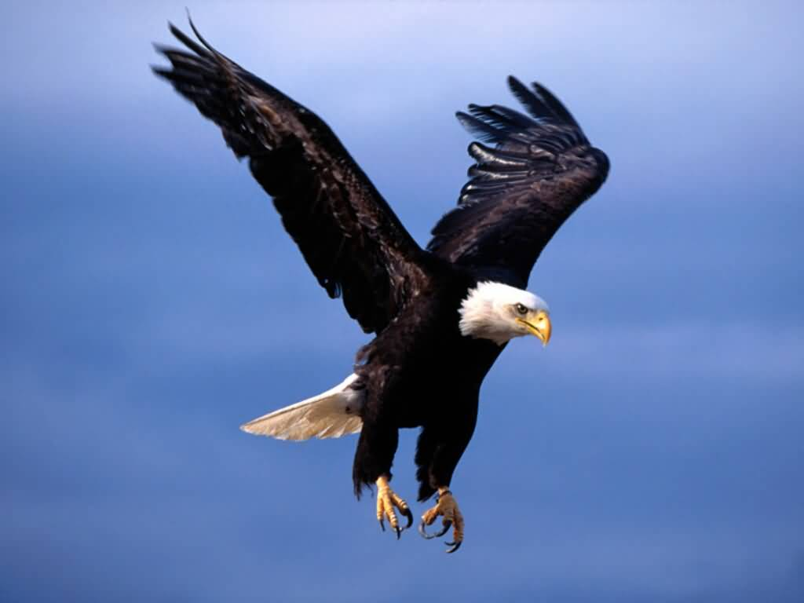
Read Chapter 1
Trace sensory imagery

Slide 28
Developmental Progress
Progression of senses in chapter one:
Hearing: the story
Sight: the father’s face
Taste: lemon platt
Touch: warm and cold
Smell: the oilsheet
Why are they in this order? What is the significance of their development?

Slide 29
Development of Relationships
First warm then cold
“His mother had a nicer smell than his father”
“Uncle Charles and Dante were older than his father and mother but Uncle Charles was older than Dante”
“The Vances lived in number seven. They had a different father and mother. They were Eileen’s father and mother. ”
“When he was grown up, he was going to marry Eileen.”
Why does Joyce highlight this relationship-oriented development?

Slide 30
Ireland’s history and context
Highly influential on Joyce & in novel
Ireland: British colony for hundreds of years; treated as inferior to English and Scottish
Example: “A Modest Proposal” by Jonathan Swift, pub. 1729 (Full title: “A Modest Proposal for Preventing the Children of Poor People in Ireland From Being a Burden on Their Parents or Country, and for Making Them Beneficial to the Publick”)
increasing agitation and desire for independence in 19th century

Slide 31
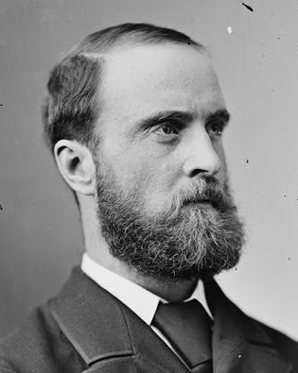
Charles Stewart Parnell: “Uncrowned King of Ireland”
27 June 1846 – 6 Oct 1891
Protestant landowner
Elected to Parliament in 1875(House of Commons)
1879: elected President of the Irish Land League (founded by Michael Davitt)
1880: elected leader of the Home Rule League
Gains prominence and power through the decade; his charisma made him the best representative of the cause

Slide 32
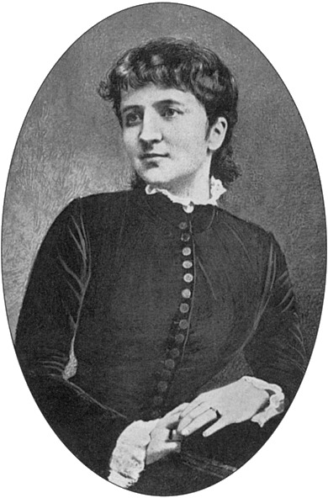
The Parnell Affair
1889: Captain William O’Shea files for divorce from his wife Katherine; Parnell is named as a defendant
Parnell and Katherine had been together for ten years; her three children were fathered by Parnell
The affair was a “public secret” but still quite scandalous in Victorian Great Britain and Catholic Ireland (adultery = cardinal sin)
Parnell didn’t refute the charges so that the divorce would be granted and he could marry Katherine
SN: Katherine = “Kitty”, slang for prostitute
Parnell and O’Shea married on June 25, 1891

Slide 33
After the Affair…
Nov. 18, 1890: INL upholds Parnell as leader
December 6, 1890: majority walks out of negotiations; “Anti-Parnellites” form Irish National Federation—includes Michael Davitt
The Catholic Church did not officially take a position on Parnell until June 1891: “by his public misconduct, [he] has utterly disqualified himself to be…a leader”
Parnell’s marriage to O’Shea did not alleviate tensions; he was still an adulterer and she, additionally, had broken vows
Suffering from kidney disease, he died on Oct. 6, 1891
His death was a shock to Ireland; over 200,000 came together to mourn their “dead king”

