Slide 1
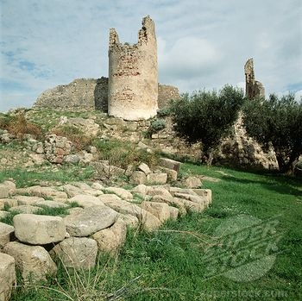
British Literature
The Medieval Period
(Middle English)

Slide 2
Welcome to England and the English… an island of peoples, languages, and divisions...
The White Tower in London…
part of William’s legacy
Chartres Cathedral
Latin -- church, schools
French -- court, castle
English -- commoners

Slide 3
What was it like to live in the Middle Ages?

Slide 4
The 3 Estates in the Middle Ages
The idea of estates, or orders, was encouraged during the Age, but this ordering was breaking down.
Clergy
Latin chiefly spoken, those who pray, purpose was to save everyone’s soul
Nobles
French chiefly spoken, those who fight, purpose was to protect—allow for all to work in peace—and provide justice
Commoners
English spoken, those who work, purpose was to feed and clothe all above them

Slide 5
feudalism
The economic system of much of the Middle Ages (800-1100)
Commoners (peasants) lived on a feudal manor. The lord of the manor gave his vassals (the peasants) land to farm.
In return, the vassals received protection from roving bandits. Yet they were taxed and had to surrender a portion of their crops to the lord.
it was better to be a lord than a vassal!
Feudalism is important as it created ties of obedience and fostered a sense of loyalty between the vassals and their lord.
A tenant (vassal) renews his oath of fealty to his lord

Slide 6
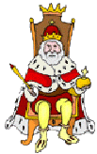
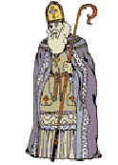
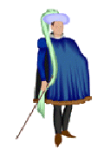
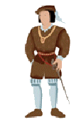
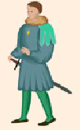
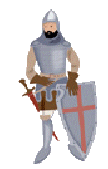
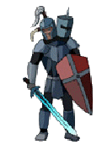
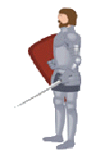
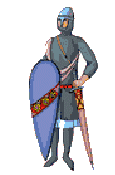
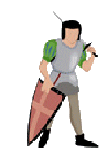
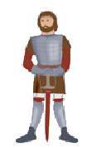
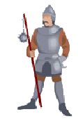
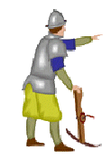
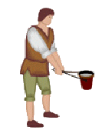
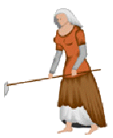
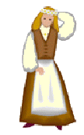
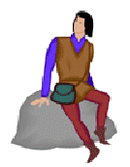
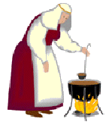
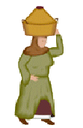
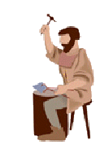
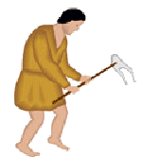
Hierarchy of Feudalism
KING
Fief and Peasants
Fief and Peasants
Loyalty
Military Aid
LORDS (VASSALS TO KING)
Food Protection Shelter
Food Protection Shelter
Homage
Military Service
KNIGHTS (VASSALS TO LORDS)
Food Protection Shelter
Farm the Land
Pay Rent
PEASANTS (SERFS)

Slide 7
Chivalry
A product of feudalism, chivalry was an idealized system of manners and morals
Restricted to nobility
The Medieval knight was bound to the chivalric code to be loyal to…
God
his lord
his lady
Chivalric ideals include...
benevolence
brotherly love
politeness
Sir Gawain is an example

Slide 8
The Church’s precepts (foundational teachings)
7 Deadly Sins
Lust
Gluttony
Greed
Sloth
Envy
Wrath
Pride
7 Heavenly Virtues
Chastity (moral purity)
Abstinence (moderation)
Liberality (generosity)
Diligence (work ethic)
Patience
Kindness
Humility

Slide 9
The Wheel of Fortune
The idea of Fortune and her wheel was one of the most pervasive ideas throughout the Middle Ages.
On the wheel are depicted four figures: one at the top, one at the bottom, one rising, and one falling.

Slide 10
It served to remind of the temporality of earthly things.
The Wheel helps understand the medieval mind, and it can help remind us that the important things in life come from within, that hard work has its own merits. An award, an office, a title--these are not the things that make for greatness.

Slide 11
Ptolemaic Universe
Imagine a sphere that encloses another that holds another that holds yet another…and continues into heaven…
It is a commonly held myth that people of the Medieval period thought the Earth was flat…FALSE!
It was round, but at the center of the universe!
So what? Well, the people of the Medieval period loved order! Remember the Three Estates, the Seven Deadly Sins—a place for everyone and everyone in that place.
Watch for this order to begin to be displaced…

Slide 13
The Great Chain of Being

Slide 15
With the Crusades comes The Black Death
spreads along trade routes
kills much of the population
the plague outbreaks occur through the Middle Ages and into the Renaissance
Paradoxically, the Plague provides for continued growth in cities
Afterwards, hundreds of new jobs available
Many debts “died off” with creditors
also contributed to society’s culture

Slide 16
Languages
Latin was the language of the Roman Catholic Church, which dominated Europe
The Church was the only source of education
Thus, Latin was a common language for Medieval writings.

Slide 17
A notable amount of medieval literature is anonymous. Medieval authors often tended to re-tell and embellish stories they heard or read rather than invent new stories.

Slide 18
Writings
Catholic clerics were the intellectual center of society in the Middle Ages, and it is their literature that was produced in the greatest quantity.

Slide 19
Characteristics of Medieval Literature
Heroism
from both Germanic and Christian traditions, sometimes mingled
Beowulf
Sir Gawain and the Green Knight
Presentations of idealized behavior
literature as moral lesson
loyalty to king
chivalry
use of kennings (especially in Beowulf)
A figurative, usually compound expression used in place of a name or noun. Example, storm of swords is a kenning for battle.

Slide 20
Use of Allegory
An allegory is a figurative mode of representation conveying a meaning other than the literal.
Much of medieval literature relied on allegory to convey the morals the author had in mind while writing--representations of abstract qualities, events, and institutions are thick in much of the literature of this time.

Slide 21
The Ideal of Courtly Love
This relationship was modeled on the feudal relationship between a knight and his liege lord.
The knight serves his courtly lady with the same obedience and loyalty which he owes to his liege lord.
She is in complete control; he owes her obedience and submission

Slide 22
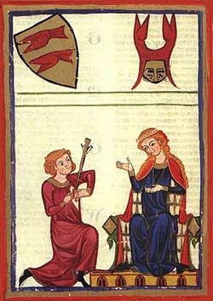
The knight's love for the lady inspires him to do great deeds, in order to be worthy of her love or to win her favor.

Slide 23
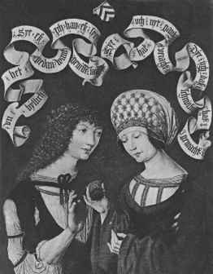
“Courtly love" was not between husband and wife because it was an idealized sort of relationship that could not exist within the context of "real life" medieval marriages.
In the middle ages, marriages amongst the nobility were typically based on practical and dynastic concerns rather than on love.

Slide 24
“Courtly love" provided a model of behavior for a class of unmarried young men who might otherwise have threatened social stability.
Knights were typically younger brothers without land of their own (hence unable to support a wife).
They became members of the household of the feudal lords whom they served.

Slide 25
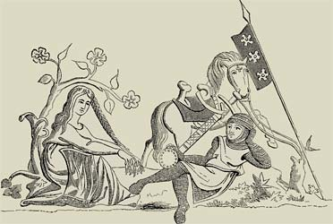
The lady is typically older, married, and of higher social status than the knight because she was modeled on the wife of the feudal lord, who might naturally become the focus of the young, unmarried knights' desire.

Slide 26
The literary model of courtly love may have been invented to provide young men with a model for appropriate behavior.
It taught them to sublimate their desires and to channel their energy into socially useful behavior (love service rather than wandering around the countryside, stealing or raping women.

Slide 27
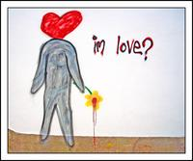
The "symptoms" of love were described as as if it were a sickness.
The "lovesick" knight’s typical symptoms: sighing, turning pale, turning red, fever, inability to sleep, eat or drink.

Slide 28
The Quest
In addition to the theme of Courtly Love, the Quest was highly important:
the code of conduct observed by a knight errant who is wandering in search of deeds of chivalry. This knight is bound by a code of behavior - a set of conventional principles and expectations

Slide 29
A quest is a hero’s journey towards a goal. The objects of quests require great exertion on the part of the hero, and the overcoming of many obstacles.
The hero's must obtain something, or someone, by the quest and with this object return home.

Slide 30
The Hero
Is often of divine descent endowed with great strength and ability" or "a man admired for his achievements and noble qualities"

Slide 31
Characteristics of Medieval Literature
Romance
Sir Gawain and the Green Knight
A narrative in prose or verse that tells of the adventures and heroic exploits of chivalric heroes
exploits of knights
often a supernatural element involved
Christian message
concern with salvation and the world to come
no interest in social change
until the late 14th century
Chaucer signals new thinking, up-ending social order

