Slide 1
The Death of Ivan Ilych
And philosophical underpinnings

Slide 2
existentialism
What do you remember about existentialism from The Stranger? List 3-5 important elements.

Slide 3
Christian Existentialism
Sound like an oxymoron? Why?

Slide 4
Søren Kierkegaard (1813-1855)
-Danish philosopher who first introduced the idea now known as Christian existentialism; a prolific writer of profound depth

Slide 5
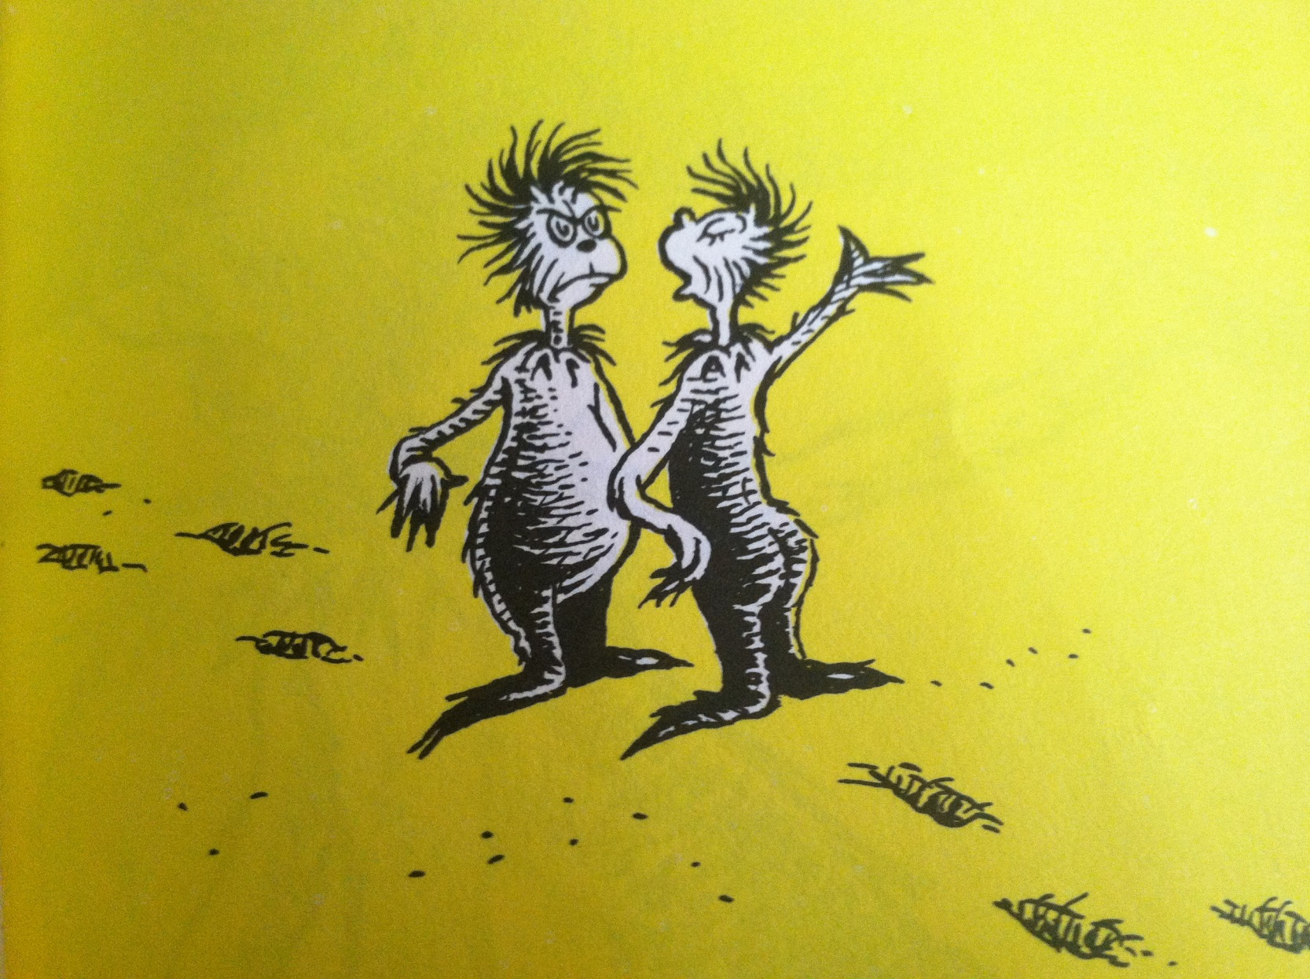
“The Zax”

Slide 6
a woeful summary:
Man has three stages in life: the aesthetic, the ethical, and the religious

Slide 7
Aesthetic:
+pursuit of pleasant but trivial goals, superficial achievements
+ easily develop feelings of emptiness and dread (AKA angst) about superficiality of life
+Kierkegaard’s belief: angst=good (provides recognition of the triviality of one’s life and pursuits, and can lead to hope of a new life)

Slide 8
Ethical:
+transcending “shallow pleasantries” of social acceptance
+attempt to do what is right personally
+Free will (!!!)

Slide 9
Religious:
surrender any concept of self, essentially consumed by God

Slide 10
Philosophy
Kierkegaard’s personal identity =faith in God
…but what kind?

Slide 11
I’m spiritual but not religious…
What does that mean?

Slide 12
Anti-church Christian?
last five years of his life= multiple essays about dangers of the Danish State Church and of ‘Christendom’ (in context, the political power of the church)

Slide 13
According to Kierkegaard--
church = empty, meaningless, and corrupt body with no connection to actual teachings of God or Jesus Christ
Most clergymen = mere officials of the church who pervert faith, not practice it
Congregations = meaningless groups that dilute the connection between man and God

Slide 14
Church = bad
no encouragement or responsibility for the individual to seek a separate and meaningful relationship; existing connection is superficial
encourages a ‘herd mentality’—the power of individual thought gets lost in the crowd

Slide 15
Anecdotal evidence
“On October 2, 1855, Kierkegaard collapsed on the street and was taken to a hospital. He stayed in the hospital for nearly a month and refused to receive communion from a priest of the church, whom Kierkegaard regarded as merely an official and not a servant of God. Kierkegaard died in Frederick's Hospital after being there for over a month, possibly from complications from a fall he had taken from a tree when he was a boy. At Kierkegaard's funeral, his nephew Henrik Lund caused a disturbance by protesting that Kierkegaard was being buried by the official church even though in his life he had broken from and denounced it. Lund was later fined.”

Slide 16
Philosophy
Now for his concept of the “leap of faith”
*remember topic is
NOT what constitutes
reality!

Slide 17
Written Response
Do you believe that pencils exist? Why?

Slide 18
Responses
you know concretely that they do; you can see one, hold one, write with one
hard to dispute that kind of empirical evidence
‘Believe’ hardly even seems like the right word because our knowledge of pencils is so definitive

Slide 19
question
Would you have to reject rationality in some way to claim that pencils don’t exist?

Slide 20
Answer
YES — the evidence is incredibly strong and rather indisputable
Knowledge of pencils = objective or reasoned truth
‘belief’ in pencils is secure precisely because of substantial proof that they exist

Slide 21
What is faith?
faith = “belief that is not based on proof”
not applicable to knowledge of pencils

Slide 22
Written response
Do you believe that love exists?
Is your belief in love as strong as your belief in pencils?
Can you provide indisputable evidence that love exists?
OR does your belief in love require faith?

Slide 23
Love is a belief
‘belief’ cannot be explained rationally; there is no presence of ‘indisputable evidence’
BELIEF REQUIRES FAITH

Slide 24
Pencils vs love
Kierkegaard = to have faith, one had to have doubt (dependent relationship)
no way to deny the existence of God if there was indisputable evidence of existence (conversely, to deny existence of pencils is irrational when I can easily throw a box of them at you)
without some doubt, one’s faith in God is not a faith worth having (connects back to criticism of the church and its operating principles)

Slide 25
Subjective truth
Therefore, belief in God is a necessary leap of faith—AKA subjective truth
A subjective truth is something which is true for a single individual, who has thought deeply and sincerely about that idea and has determined that this important idea is true for him/her—but not necessarily for everyone else (I have a feeling Kierkegaard wouldn’t get fanaticism…kind of like another guy we know.)

Slide 26
Kierkegaard
“If I am capable of grasping God objectively, I do not believe, but precisely because I cannot do this I must believe. If I wish to preserve myself in faith I must constantly be intent upon holding fast the objective uncertainty, so as to remain out upon the deep, over seventy thousand fathoms of water, still preserving my faith.”

Slide 27
How does this connect to existentialism?
Think back to Kierkegaard’s problems with the church. What role does the individual play? What role should the individual play?

Slide 28
Philosophy
Kierkegaard believed that no relationship with God was significant or fulfilling unless it relied exclusively on one person’s passionate beliefs

Slide 29
question
What was more interesting to you personally: questioning belief in pencils or belief in love? Why?

Slide 30
response
I’m going to guess love; there’s nothing interesting or thought-provoking about an objective truth about pencils. It doesn’t make me examine my life in any way. It is of no importance to me personally to prove or disprove the existence of pencils.
Love, on the other hand, or the existence of God, does connect to my life. It is thought-provoking. And it’s more interesting because it is a subjective truth and not an objective truth. It’s also something that requires faith, and thus some element of doubt. It is something which is essential to my existence.

Slide 31
philosophy
connecting thread: the most important elements of an individual’s existence are the significant, subjective choices that s/he makes that relate to that existence—this is what counts toward a meaningful life
This is basically existentialism!

Slide 32
Tolstoy’s connection
Tolstoy: after Anna Karenina, midlife crisis
No point in living if he didn’t figure out what the purpose of life
He experienced a significant religious conversion, embraced ideas like communal living, non-violence, and anarchism
The Death of Ivan Ilych is the first piece of literature he wrote after his conversion (he published A Confession in 1881, which was a personal statement on his new views)

Slide 33
The big question:
Does theistic or Christian existentialism play a role in The Death of Ivan Ilych?

