Slide 1
Introduction to Othello
English 4/DiMatteo

Slide 2
Journal Topic
Have you ever felt JEALOUS? Describe the situation, what brought on your jealousy, and how the situation ended.
How does your opinion of jealousy compare to that of courtly love? “No man who is not jealous can love.”

Slide 3
Shakespeare
What do you know?

Slide 4
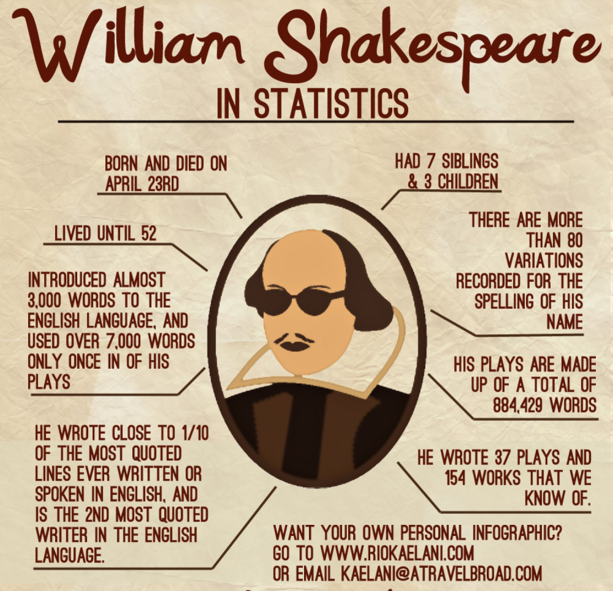
Shakespeare
b. 1564
d. 1616
Grew up in Stratford-upon-Avon
Married Anne Hathaway in 1582
(he was 18, she was 26)
Susanna born 5 months later
Twins: Judith and Hamnet, 1585
Hamnet dies in 1596
1585-1592: the “lost” years
1596-1606: the productive years

Slide 5
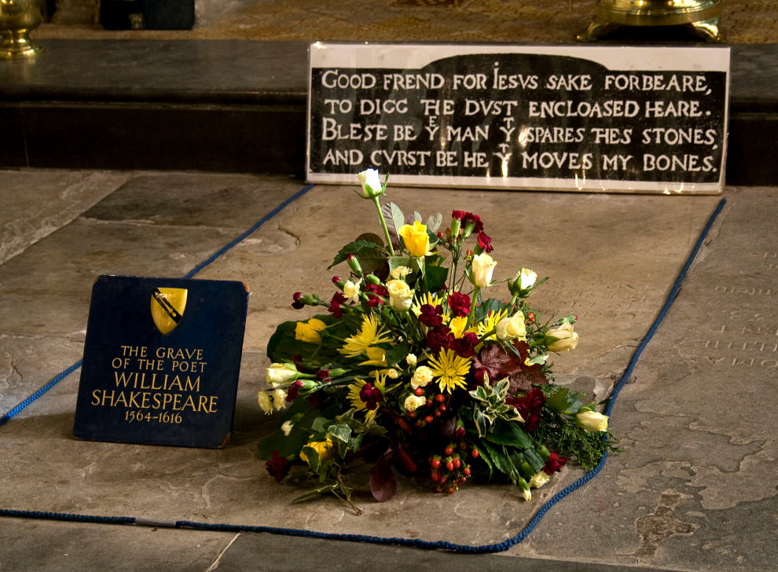
Shakespeare
Actor, playwright, poet (director?)
Lord Chamberlain’s Men
King’s Men
The Globe Theater
Interesting will and epitaph…

Slide 6
Renaissance Geography

Slide 7
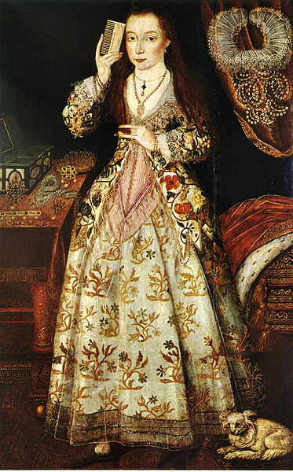
British Dudes and Chicks
OMG. I’m so rich and bored.
You should get a hobby like brushing your hair.

Slide 8
And then there’s this guy
Moroccan ambassador to Elizabeth, Abd el-Ouahed ben Messaoud, in 1600

Slide 9
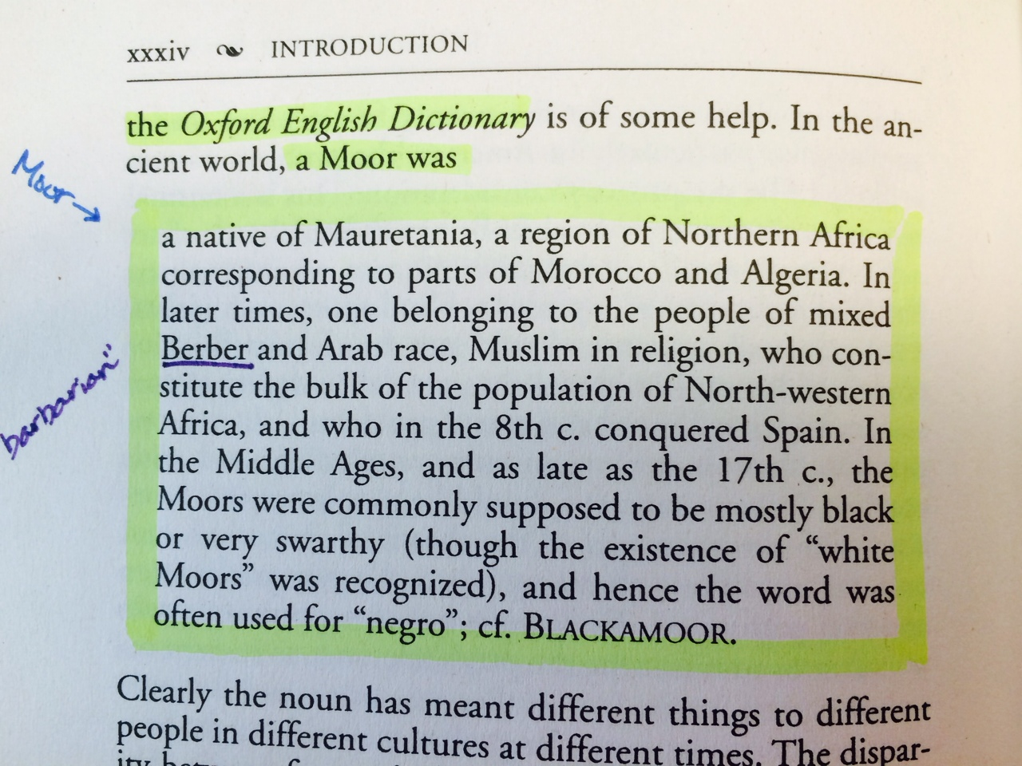
What is a “moor”?

Slide 10
dissection
The Tragedy of Othello
The Moor of Venice
Connotations?
Unfamiliar words?
Foreshadowing?
Location?

Slide 11
Need to know
Act = Roman Numeral (I, II, III, IV, V)
Scene + Line = Arabic Numeral
Citation: I. 2. 40-41
Prose/rhyme/couplets
Iambic pentameter
“Thou toldst me thou didst hold him in thy hate.” (I.1.7)

Slide 12
Plot structure
Always five acts!

Slide 13
Themes/motifs
Identity
Race
Love/loyalty
Gender roles and expectations
Hate/jealousy/manipulation

Slide 14
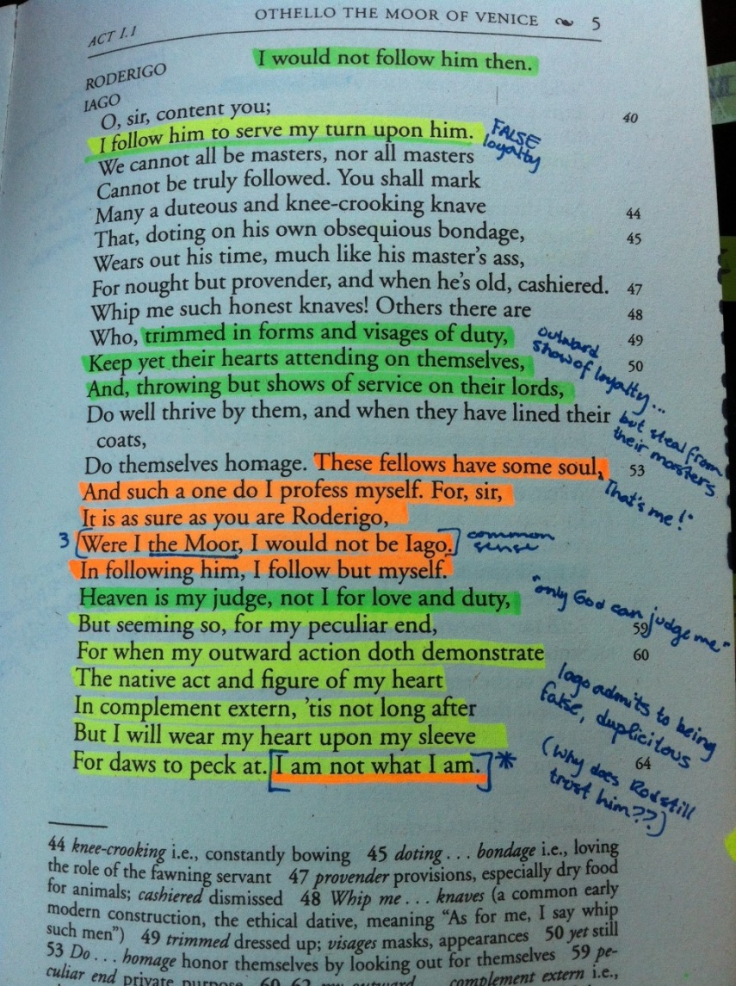
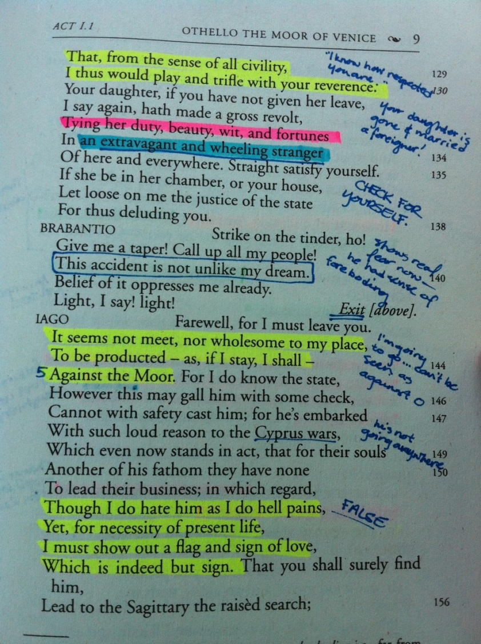
Annotation/colormarking Excellence!

