Slide 1
Romanticism
American

Slide 2
Romanticism!
So…what is it?
Brainstorm 3 or so ideas.
http://www.youtube.com/watch?v=q19uWTuqXUc

Slide 3
Romanticism is…
NOT THIS.

Slide 4
Romanticism is…
Not even this.

Slide 5
Romanticism is…
Not this, either. But did I weird you out?
;)

Slide 6
Romanticism: 1800-1860
Backlash to the Enlightenment and the Age of Reason—the pendulum swings!
1700’s 1800’s
Head----------------------------------------------------------------Heart
Began in Germany in 1770’s then spread across Europe, reaching America in early 1800’s
What do you notice in common with the following images?

Slide 7
Autumn on Hudson River

Slide 8
Immigrants Crossing the Plains

Slide 9
Kindred Spirits

Slide 10
NATURE!
Artists are “inspired creators,” not technical masters
Inspiration comes from myth, legend, and folklore
Science destroys the mysteries of nature
Man communes with God (or the Divine Being) through nature
Poetry is the highest expression of imagination

Slide 11
The 5 I’s:
Imagination→necessary for creation of art
Intuition → feeling over reason
Individualism → independent thought
Idealism → making the world a better place
Inspiration → NATURE, using imagination

Slide 12
The Romantic Hero
Rational Hero | Romantic Hero
Worldly | Intuitive
Educated; Honor based on social expectations | Devoted to a higher purpose; honor comes from principles
Sophisticated | Youthful and innocent
Connected to Civilization | Loves nature; avoids town life (idealized Native Americans)
Benjamin Franklin | Natty Bumppo/ Last of the Mohicans

Slide 13
When I Heard the Learn’d Astronomer
WHEN I heard the learn’d astronomer;
When the proofs, the figures, were ranged in columns before me;
When I was shown the charts and the diagrams, to add, divide, and measure them;
When I, sitting, heard the astronomer, where he lectured with much applause in the lecture-room,
How soon, unaccountable, I became tired and sick;
Till rising and gliding out, I wander’d off by myself,
In the mystical moist night-air, and from time to time,
Look’d up in perfect silence at the stars.
Walt Whitman

Slide 14
How does Whitman’s poem reflect a Romantic attitude?

Slide 15
Dark Romanticism
Demonstrates emphasis of feelings
Focused on the dark side of humanity
Highlights how interfering with nature can lead to horrific results
Emphasized man’s fallibility and tendency toward sin and self-destruction

Slide 16
Edgar Allen Poe: January 19, 1809 – October 7, 1849
Short stories:
“The Black Cat”
“The Pit and the Pendulum”
“The Cask of Amontillado”
Poems:
“The Raven”
“Annabel Lee”
“Bells”
Fixated on exposing the dark side of human nature when passion overtakes reason

Slide 17
Nathaniel Hawthorne: 1804-1864
The Scarlet Letter
The House of Seven Gables
“Young Goodman Brown”
“Rappaccini’s Daughter”
“The Birthmark”
“The Minister’s Black Veil”
Examines how religious beliefs affect a person’s decision-making
*good/evil
*sinner/saint
*guilt/redemption
Do you remember who his great-grandfather was???

Slide 18
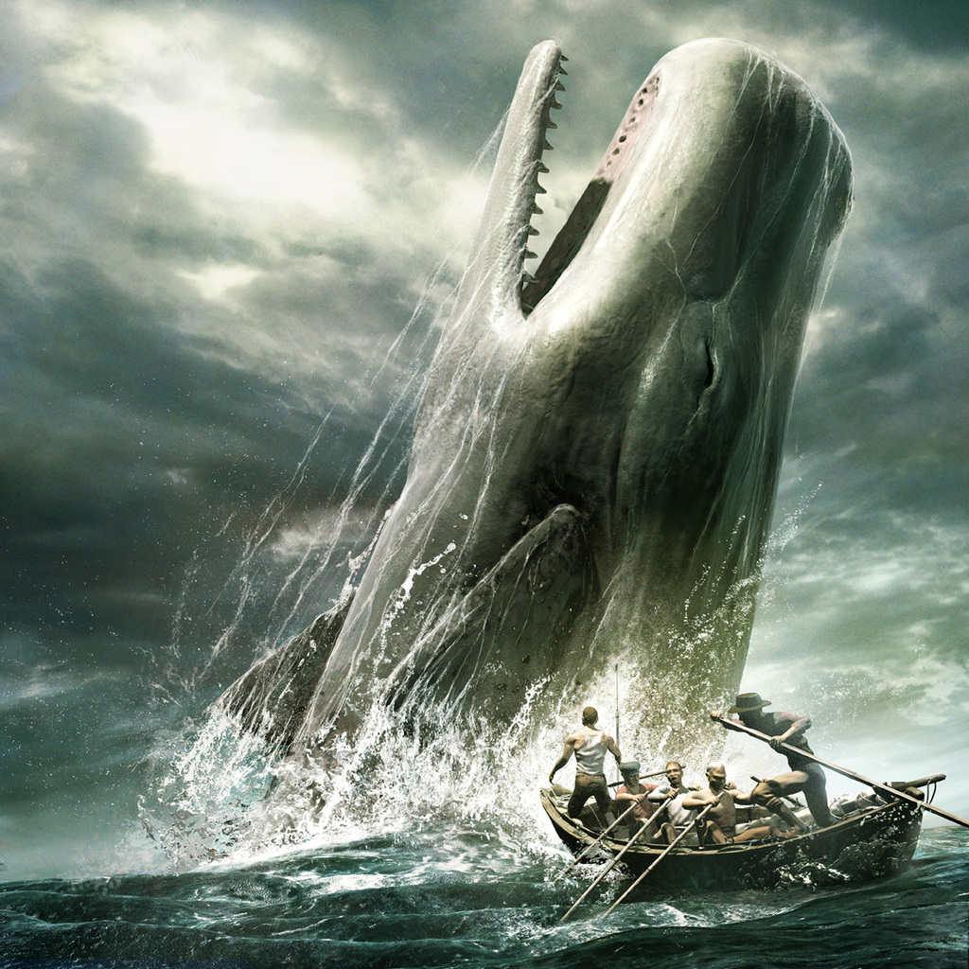
Herman Melville: 1819-1891
Moby Dick
Bartleby the Scrivener
Billy Budd
Exposes the effects of obsession on humans—leads to madness and death

Slide 19
Transcendentalism
Literature + philosophy
Definition: going beyond (transcending) daily human experience in the real world to achieve a closer relationship with the Divine Soul
Cities are too crowded, dirty, and corrupt; to forget trivial worries and to connect with God, go into nature

Slide 20
Transcendentalism
“That government is best which governs least.”
Idealistic; generally considered optimists
Most important characteristics: self-reliance and individualism (as opposed to obeying authority and conforming to social norms)
Politics: limited government, favored abolition of slavery

Slide 21
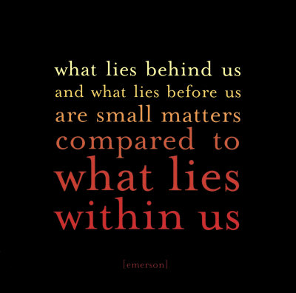
Ralph Waldo Emerson: 1803-1882
Writings include:
Self-Reliance
Nature
Mentor to Thoreau
Owned land at Walden pond

Slide 22
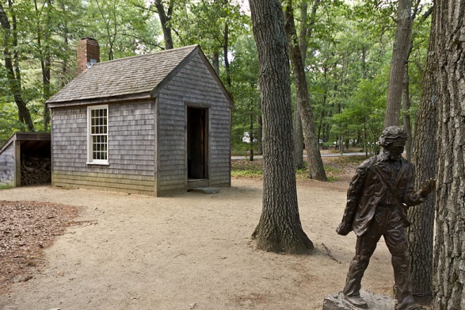
Henry David Thoreau: 1817-1862

Slide 23
Walden; or Life in the Woods

Slide 24
Resistance to Civil Government, AKA Civil Disobedience (1849)
Mohatma Gandhi:
Thoreau was a great writer, philosopher, poet, and withal a most practical man, that is, he taught nothing he was not prepared to practice in himself. He was one of the greatest and most moral men America has produced. He went to jail for the sake of his principles and suffering humanity. His essay has, therefore, been sanctified by suffering. (1907)
Martin Luther King, Jr.:
During my student days I read Henry David Thoreau's essay On Civil Disobedience for the first time. Here, in this courageous New Englander's refusal to pay his taxes and his choice of jail rather than support a war that would spread slavery's territory into Mexico, I made my first contact with the theory of nonviolent resistance…
I became convinced that noncooperation with evil is as much a moral obligation as is cooperation with good. As a result of his writings and personal witness, we are the heirs of a legacy of creative protest. The teachings of Thoreau came alive in our civil rights movement… (1963)

